Slide 1
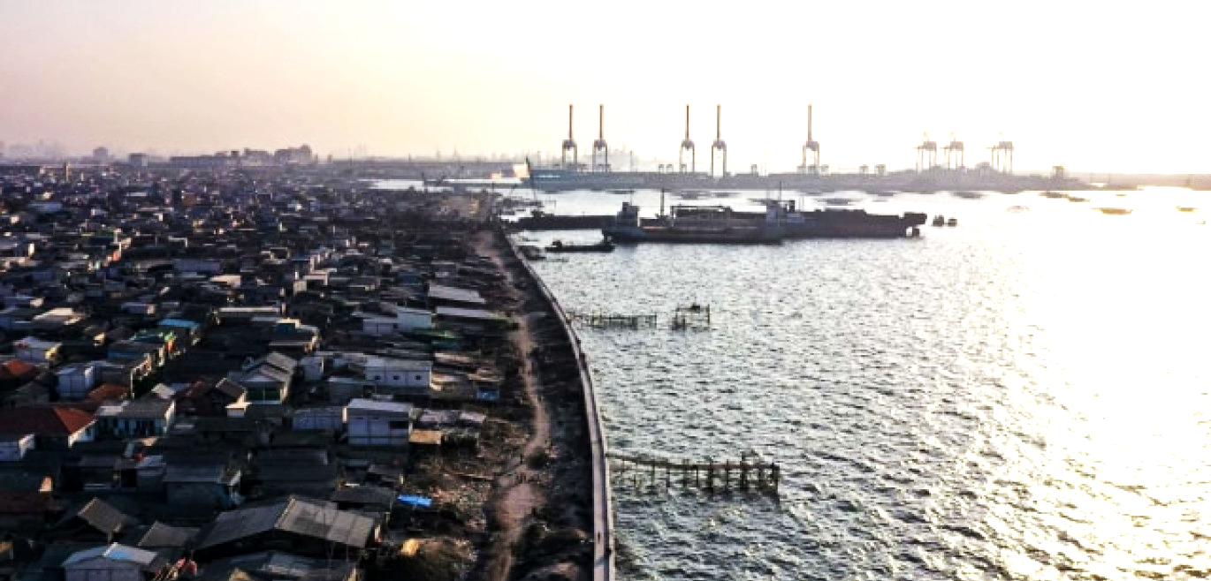
Jakarta Baywatch Team
POLICY BRIEF:
RECLAIMING COASTAL RESILIENCE
JUDUL LAMA:
RECLAIMING COASTAL RESILIENCE THROUGH LBF COLLECTIVE EFFORT
THROUGH COLLECTIVE PLANNING
Hack4Resilient
IN JAKARTA

Slide 2
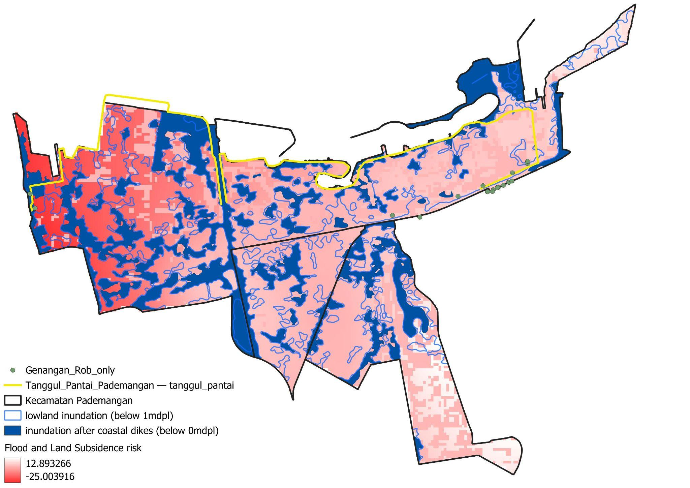
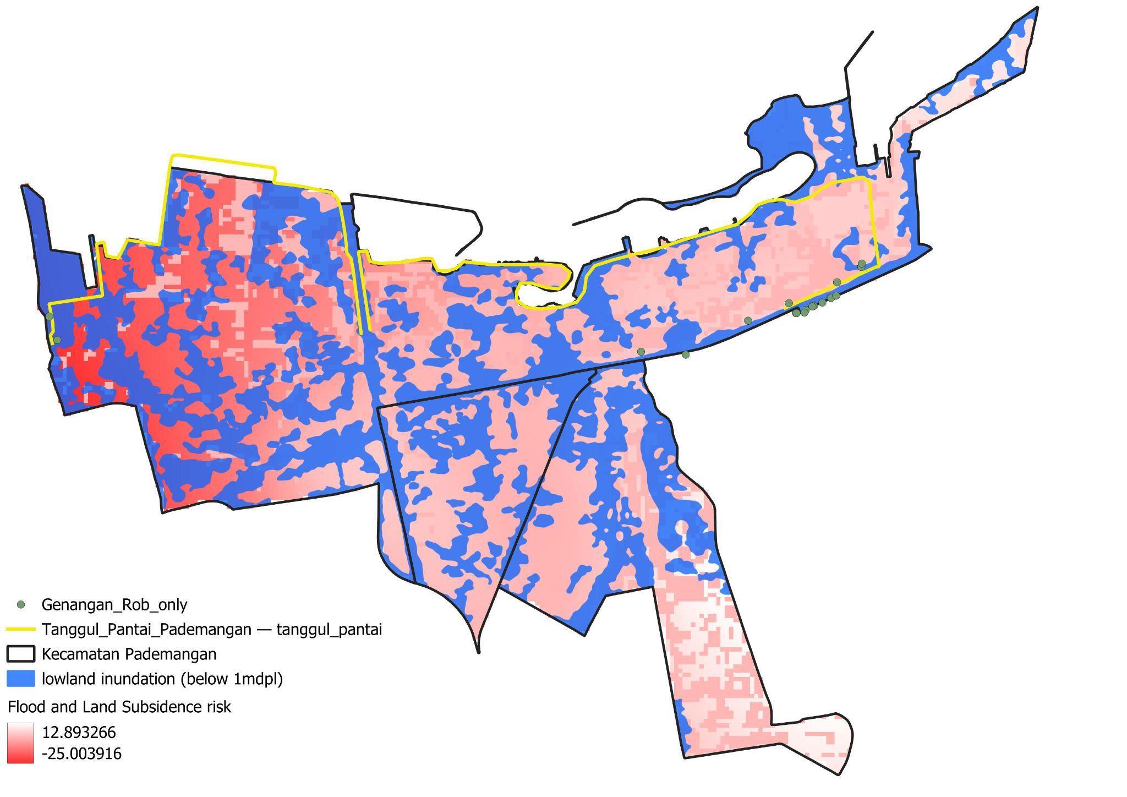
Intro to Coastal Flooding
Jakarta's coastal flooding is a persistent annual urban challenge, mainly caused by land subsidence, excessive groundwater extraction, and inadequate ecological protection.
Pemprov DKI Jakarta has undertaken various efforts to mitigate coastal risks, including constructing coastal dikes along the coastline.
However, the current infrastructure plan is inadequate to address persistent inundation caused by rainfall and excess river volume.
We chose Kecamatan Pademangan to narrow the research scope under the limited time given.
TBU: Peta Kecamatan Pademangan, menunjukkan tanggul pantai di sepanjang pesisir, plus dampaknya (positif) terhadap coastal flooding
TBU: Peta Kecamatan Pademangan, menjelaskan problem coastal flooding di Pademangan (land subsidence, topografi, kampung yang affected di Kecamatan tsb)
Notes:
Bagian tami: pikirin flow-funding (skemanya, bagi: kategorisasi pembayarnya, bagi shopping listnya gimana, apa yg masuk ke topdown apa yg masuk ke grass-root, menjelaskan skema LVC nya -> pembebasan pajak vs shopping list dll)

Slide 3
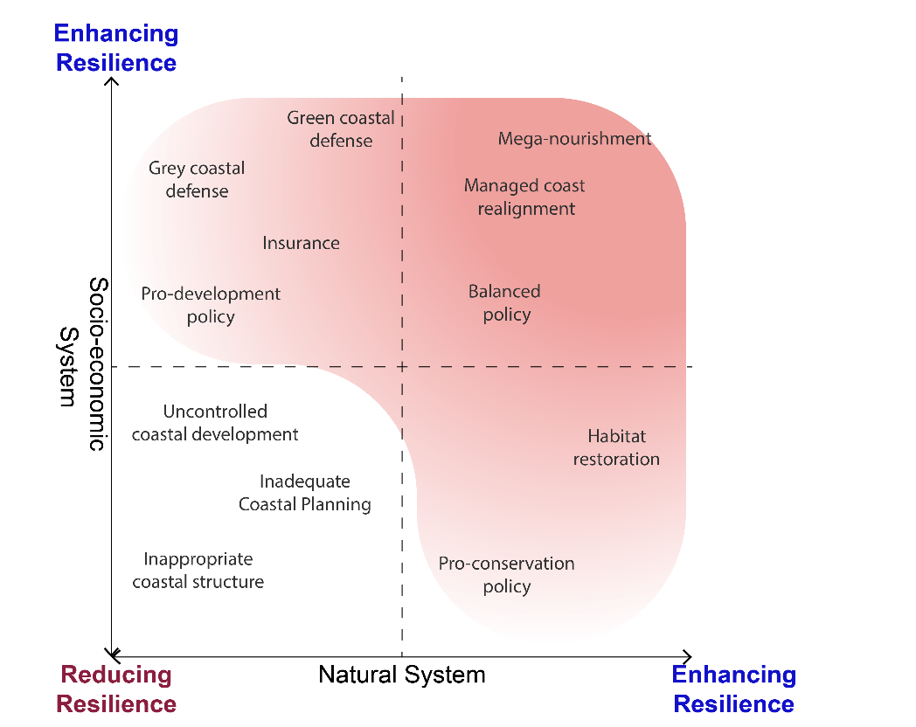
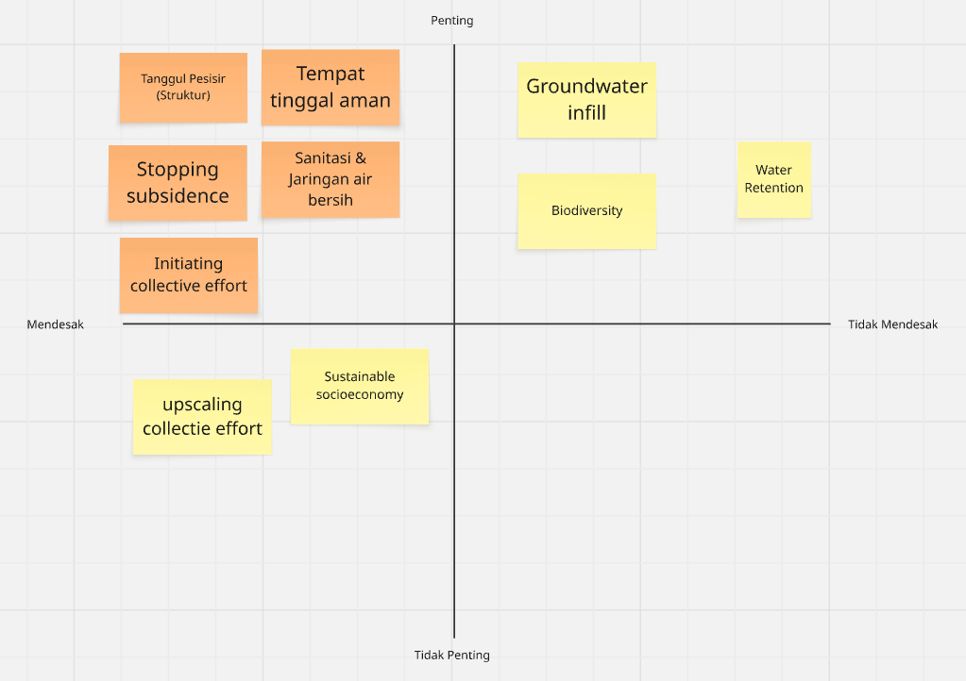
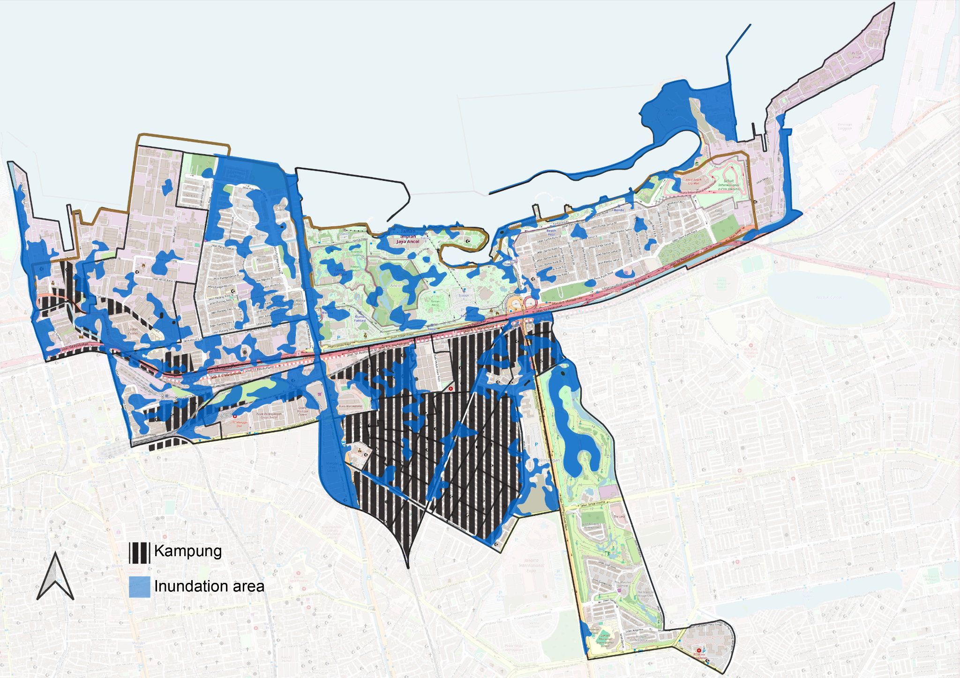
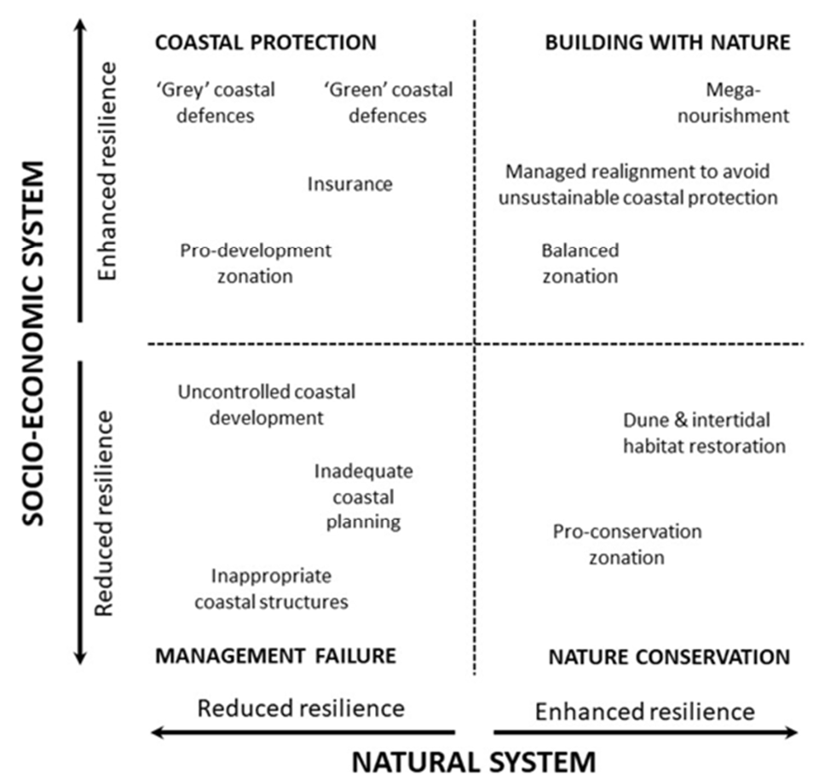
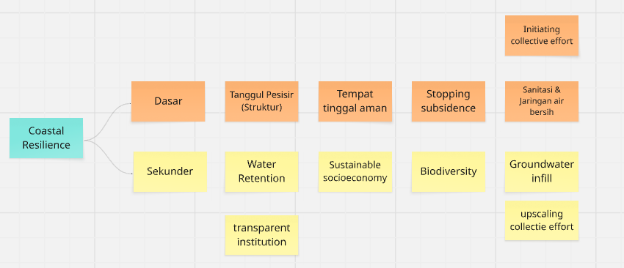
However…
in order to address coastal flooding more extensive and comprehensive requires coastal resilience that comprises of primary and complementary measures.
Balancing Coastal Resilience
Ramu dengan teoretis yg ditemuin winu tadi
To balance the socio-economic and natural system resilience in Pademangan, one should consider the significant presence of kampung in the district and see them as an equal partner.
Coastal resilience ideally enhances both the socio-economic system and the natural system resilience¹.
Implementing coastal resilience requires a balance between socio-economic and natural systems.
¹Masselink, G., & Lazarus, E. (2019). Defining Coastal Resilience. Water, 11(12), 2587. https://doi.org/10.3390/w1112258

Slide 4
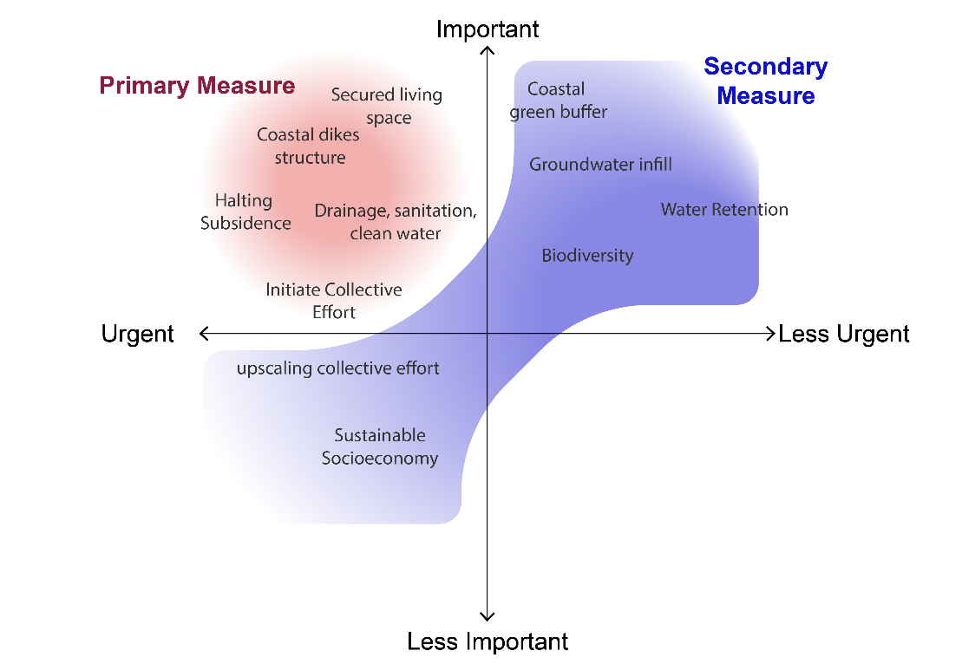
However…
in order to address coastal flooding more extensive and comprehensive requires coastal resilience that comprises of primary and complementary measures.
Coastal Resilience Measures
Ramu dengan teoretis yg ditemuin winu tadi
We identify coastal resilience prudence that comprises primary and complementary measures to address coastal flooding more extensively and comprehensively in a constrained budget.
By integrating kampung human resources and their perspectives as important factors on the secondary measure, we will ensure that the primary measure can be sustained in the long run while also promoting equity in North Jakarta.

Slide 5
Menerapkan coastal resiliency memerlukan socioeconomic system dan natural system yang seimbang.
Pendekatan bottom up yang ideal adalah menerapkan citizen participation yang setidaknya mencapai level partnership atau lebih
Sebagai bentuk penyelesaian resiliensi pesisir untuk kelompok menengah ke bawah.
Kampung Community Planning
The financial support will be the basis for implementing the resilience program. The requirement for funding is that a pre-existing cooperative must have been established.
Communities in cooperative schemes decide on coastal resilience planning within their own scope of areas
Citizen Control
Degree of citizen power
Delegated power
Kampung community collectives work collaboratively together with entrepreneurs and the government to determine ground rules and mechanisms.
Partnership
The community will determine the priority scale and approach so that coastal resilience can be achieved.
Placation
Degree of tokenism
Consultation
The ideal bottom-up approach involves citizen participation that reaches at least the partnership level or higher to address coastal resilience for lower-middle-income communities.
However, this participatory approach will only be effective if the kampung residents have already consolidated and formed a collective agreement and systems, namely cooperatives.
(Adapted from: Arnstein, 1969)
Informing
Therapy
No participation
Manipulation
¹Arnstein, S. R. (1969). A Ladder Of Citizen Participation. Journal of the American Institute of Planners, 35(4), 216–224. https://doi.org/10.1080/01944366908977225

Slide 6
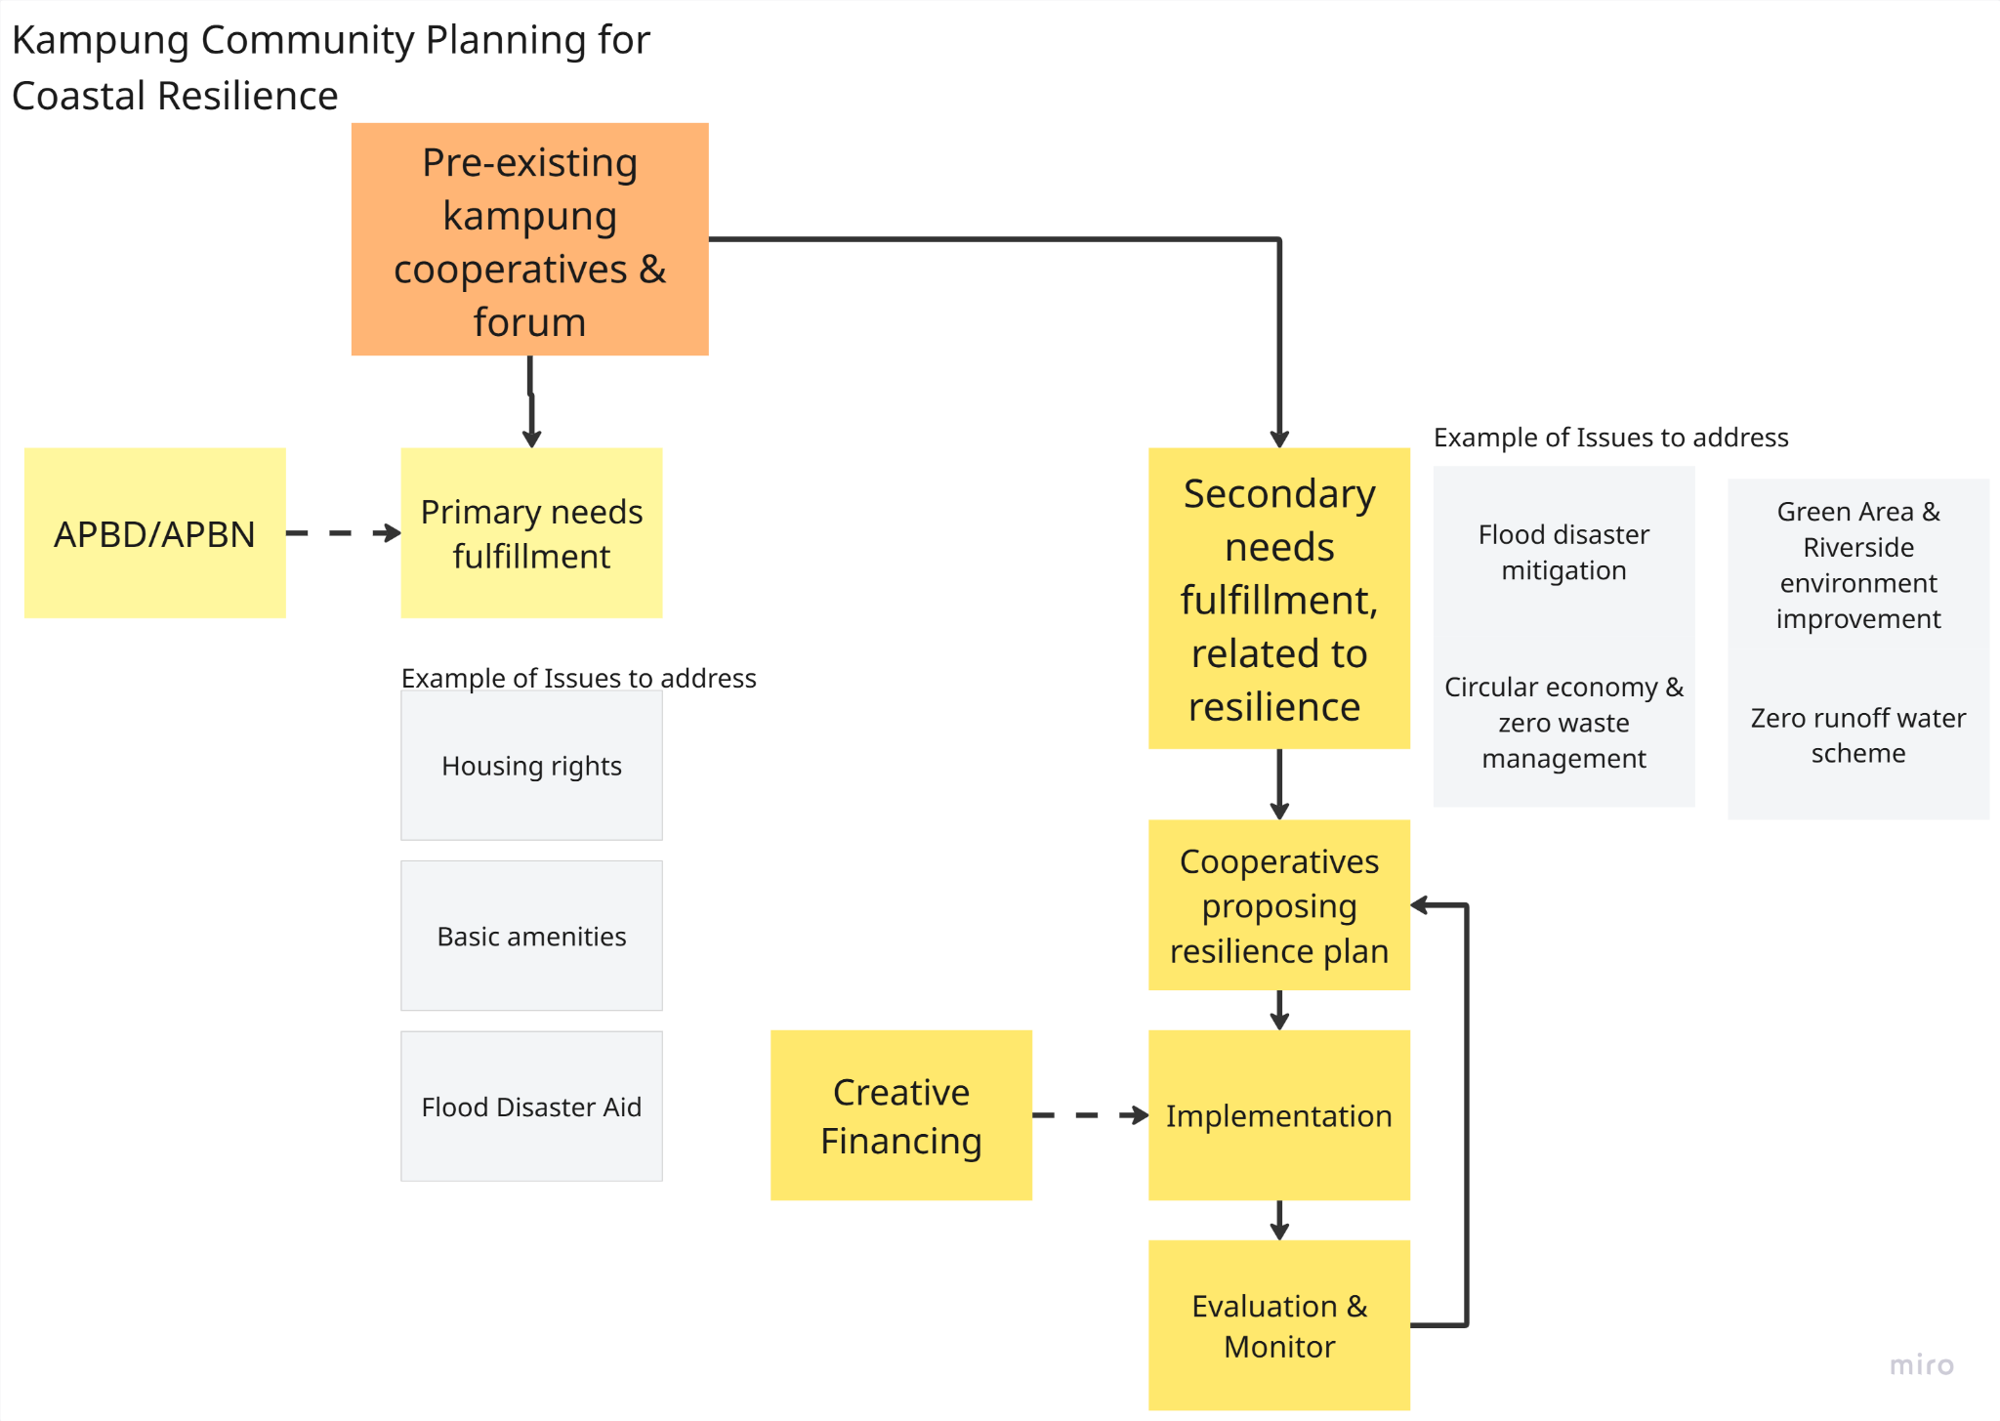
Kampung Community Plan:
Formulating Resilience Project List
Shopping list itu hrs include benefit nya ke area mana (direct dan/atau indirect), durasi project
Shopping list dibuat menjadi bundles: misal bundle environment, bundle social, bundle economy. Dimana disetiap bundle itu pasti ada selipan untuk support kampung community plan.
2 Jenis shopping list: Shopping list top down (di tempat2 yang publicly owned) Shopping list grassroot (membuat skema bagaimana kampung propose resilience nya mereka sendiri)
What kind of resilience program output that can be proposed by kampung cooperatives? Ways to engage it with third party facilitators, policy maker, and other related stakeholders
Project List Examples for Zero Runoff Resilience:
Water retention on public land and amenities
Soil infiltration well
Reservoir
Cooperatives financing
Flood mitigation training
Project List Examples for Resilient Greenery:
Coastal Wetland
Ecological park
Riverside improvement
Local plant nursery
Circular green economy
Masyarakat lebih sehat, kemudian lebih bisa produktif dan aktualisasi diri

Slide 7
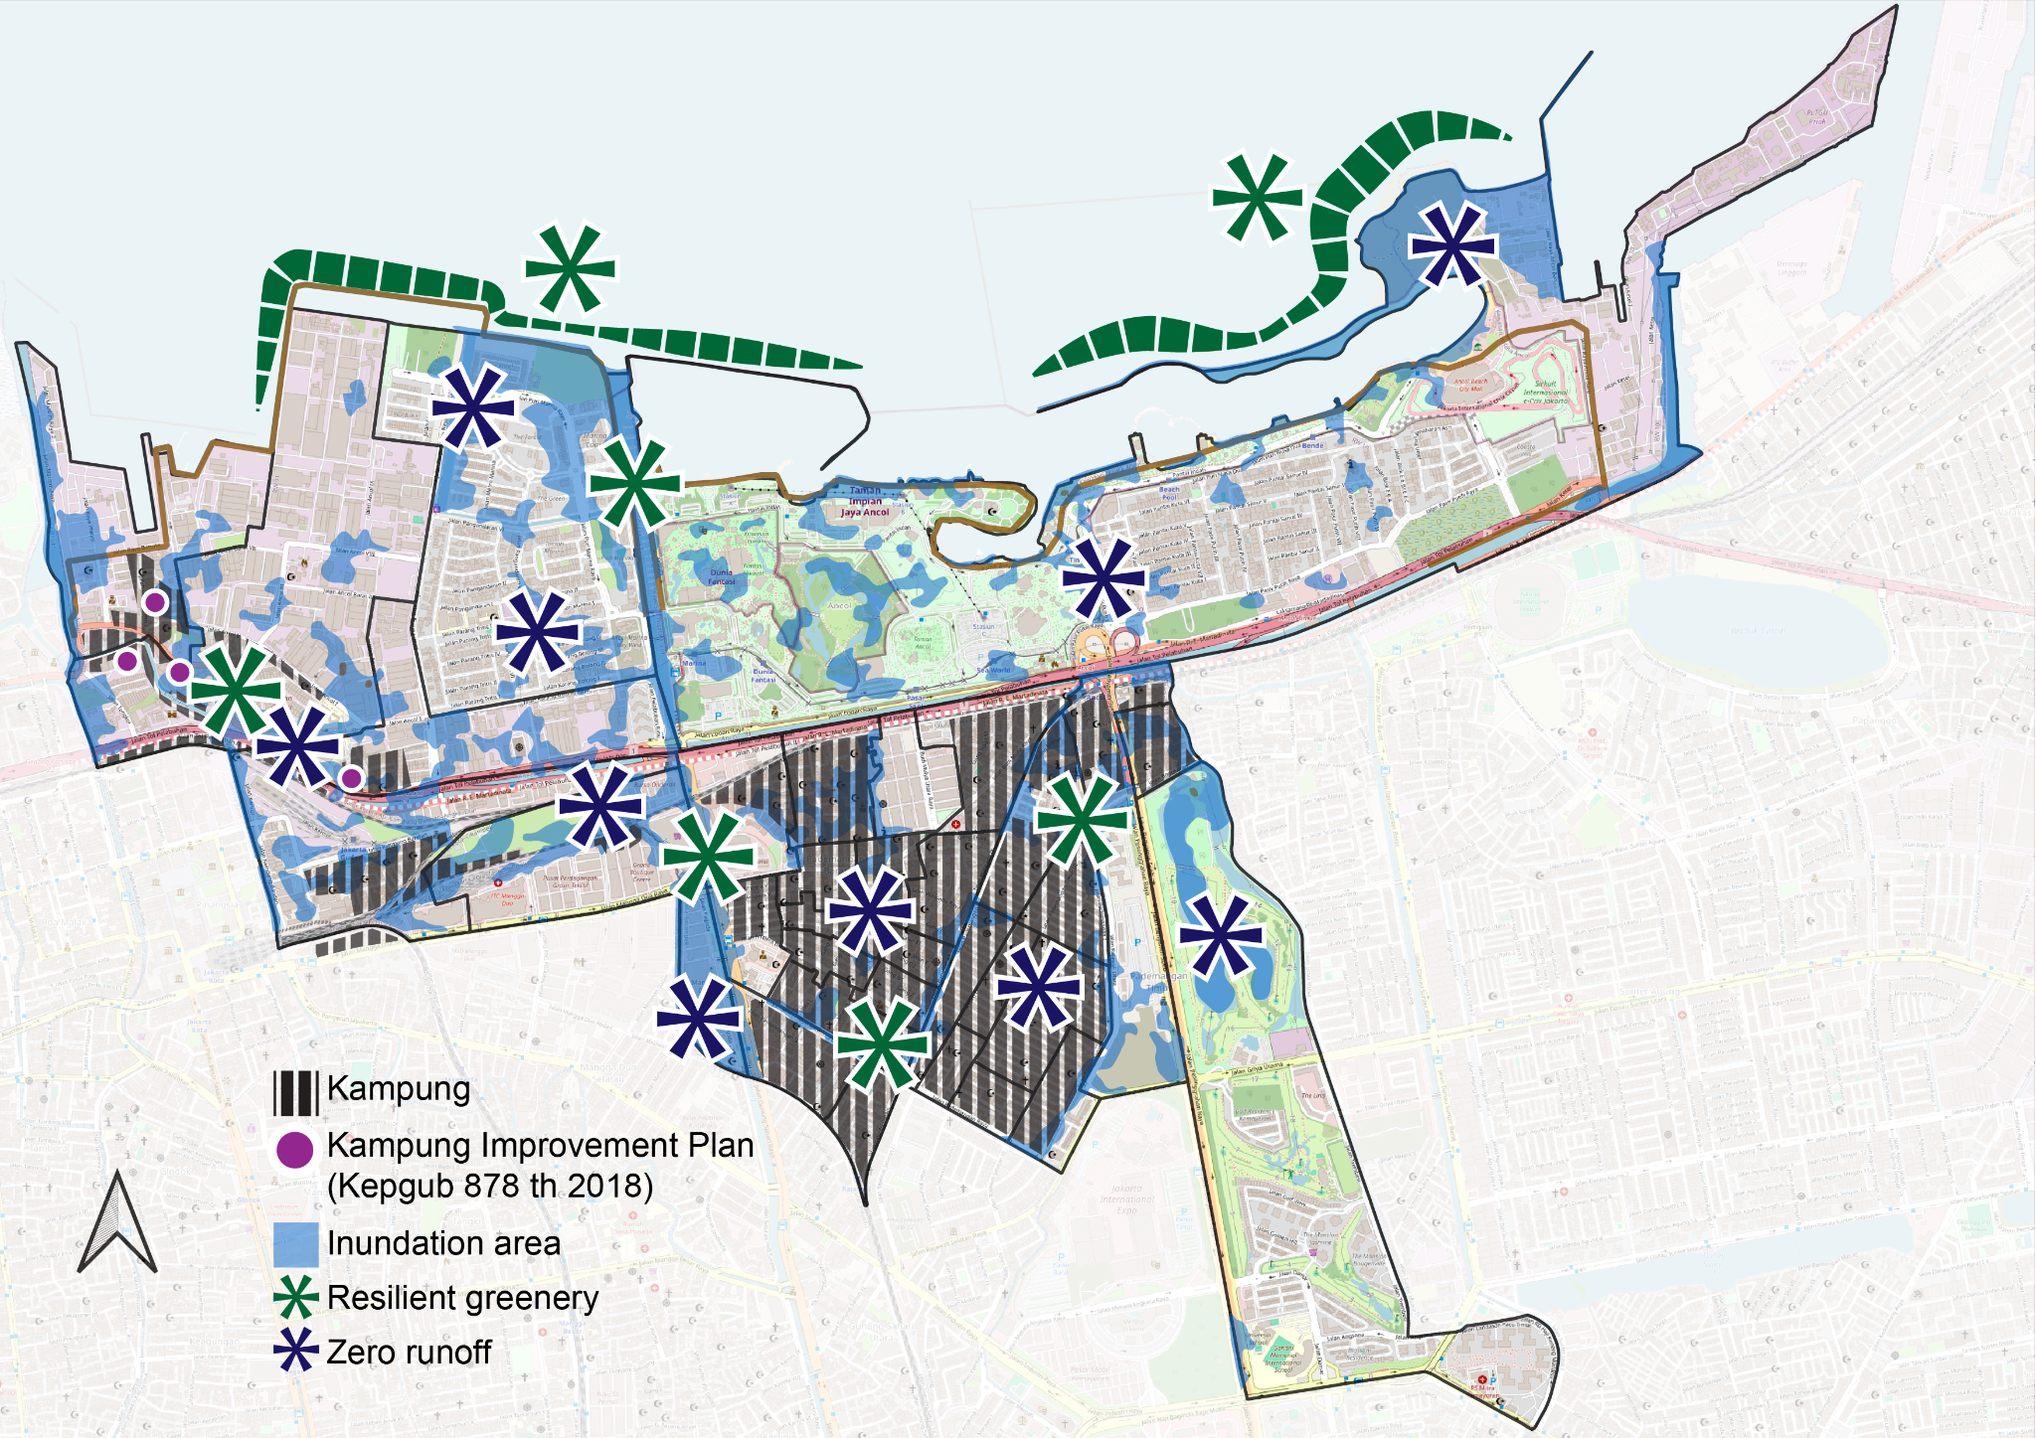
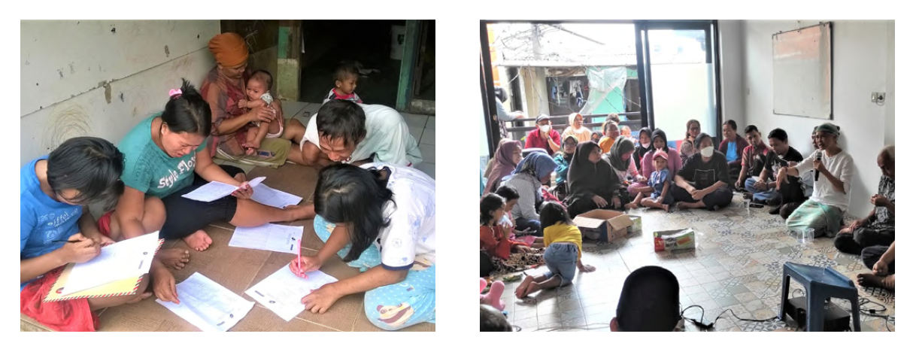
Kampung Community Plan: Implementing
Ambil 1 percontohan kampung.
Bahwa end result yg diharapkan, kampung ini bisa produce suatu project list yg dilengkapi dengan value impact yg menyasar ke enterprises sekitar (termasuk mapping enterprises yg diajak kerjasama), untuk bisa masukin pendanaan skema LBF
Contoh kampung: Kampung Tongkol KAKC
TBU: Peta yg sama dengan PETA 3 slide 2 —> peta project list
Tapi skala sekitar kampung
Pilot project implementation in a kampung with a pre-existing cooperative scheme.
Resilience participatory planning can be prioritized based on the Kampung listed on the Kampung Improvement Plan based on Kepgub DKI Number 878 Year 2018.¹
TBU: Peta enterprises yang jadi target untuk LBF → yang mendapat eksternalitas positif dari complementary measures ini
Examples of community action plan in Kampung Tongkol.²
¹Keputusan Gubernur Nomor 878 Tahun 2018 tentang Gugus Tugas Pelaksanaan Penataan Kampung dan Masyarakat
²Asian Coalition for Housing Rights. (2019). Kampung Tongkol: Case Studies of Collective Housing in Asian Cities Series. http://www.achr.net/upload/downloads/file_230731123736.pdf
TBU: Peta Kecamatan Pademangan, menunjukkan complementary measures yg bisa dibuat, plus dampaknya terhadap coastal flooding
Notes:
Cari backup teoretis atau study case real

Slide 8
Stakeholder mapping
Immediate Effect
Indirect Effect
Infrastructure Phasing
Primary Infra (i.e. dikes)
Secondary infra (i.e. NBS)
Local residents
Reduced Flood Risk
Improved Health and Sanitation
Suppressing loss and damage
Improved Quality of Life
Self Actualization
Fishermen
Safer and Accessible Harbour
Sustainable produce
Expansion (to tourism/edu)
Small enterprise
Consistent Business Operations
Business Growth
Business Expansion
Targeted Source for Financing
Medium enterprise
Coastal Resilience Infrastructure Benefits
Big enterprise
Uninterrupted Production
Logistics and transport
Climate Adaptive Transmission and Distribution
Minimum downtime
Business Growth
Industry
Stable manufacturing and supply chain
Non Human (Environment)
Restored Coastal Ecosystems
Ecological Enhancement
Improving Biodiversity
Greenery Expansion

Slide 9
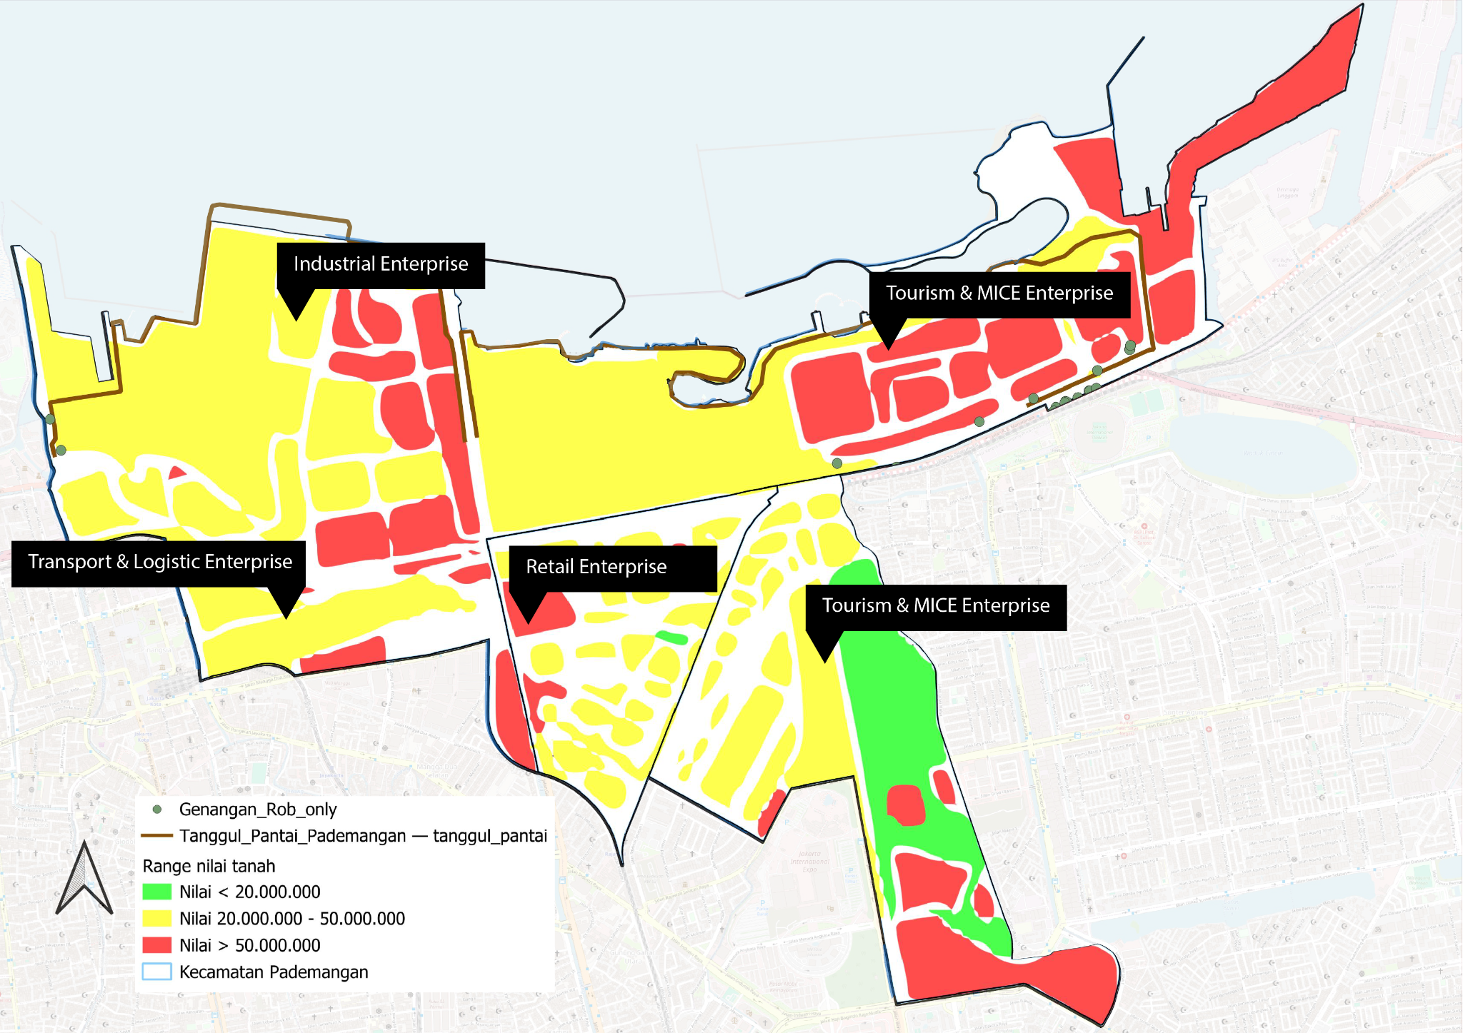
Stakeholder mapping
Mapping the stakeholders will help to identify the target enterprise for financing and their potential gain from the resilience primary and secondary measures.

Slide 10
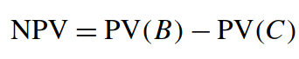
Cost-Benefit Analysis Reference
To attract targeted private sectors stakeholders and encourage their contribution, a Cost-Benefit Analysis (CBA) should be presented alongside the project list.
Kampung cooperatives will need to have the capacity, and/or receive facilitation, to produce this CBA.
Options for Financing Sources
Private Sector
Corporate Social Responsibility
The documents will enable CSR contributions to be appropriately targeted, ensuring company funds directly address community and environmental priorities.
Expected Annual Damage (EAD) is a common indicator to quantify the economic impact of potential hazards or risks.
To quantify EAD, flood damage should be calculated, ideally using a hydrodynamic model and damage curve.
CBA Reference
1
Land Value Capture
With support of the documents, enterprises can clearly see and experience the benefits of their contributions, as investments are linked to tangible improvements in the surrounding area.
Net Present Value
Benefit
Cost
Initial Investment + Maintenance costs
Direct Benefit = Avoided Expected Annual Damage (EAD)
EAD
-
2
Baseline
EAD
Scenarios
To secure public funding, the documents will be channeled via Musrenbang (from RT/RW to sub-district level) to be formally included in regional planning instruments such as RKPD and/or RPJMD.
Public Sector
Through Musrenbang
NPV > 0 → The project is feasible, as the benefits exceed the costs.
NPV < 0 → The project is not feasible, as the costs outweigh the benefits.
NPV = 0 → The project breaks even.
¹Amadio et al.(2022). Cost–benefit analysis of coastal flood defence measures in the North Adriatic Sea.
²Ruangpan, L, et al. (2024). Economic assessment of nature-based solutions to reduce flood risk and enhance co-benefits.

Slide 11
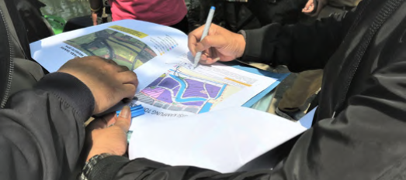
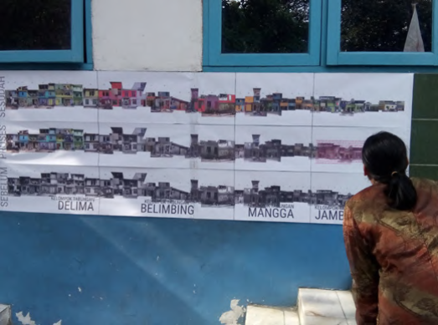
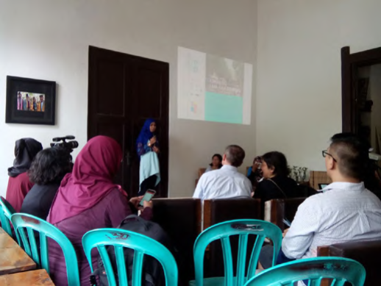
Conclusion & What’s Next?
Problem Statement
In order to reach a more sustainable coastal resilience, socio-economic system and natural system needed to be mutually enhanced.
Thus, a bottom-up approach through Kampung Cooperatives is important to complement primary measures.
Proposed Scheme
Facilitating and engaging Kampung Cooperatives to produce a Resilient Project List alongside its Cost Benefit Analysis (CBA)
The Resilient Project List and CBA is a planning document collectively produced by the local, and will be used to engage both private and public sector to contribute through various financing means.
Potential Next Steps
Monitoring & Evaluation scheme needed to be developed.
Bridging Kampung Cooperatives and Neighborhood Administrative System (RT/RW).
Images: Asian Coalition for Housing Rights. (2019). Kampung Tongkol: Case Studies of Collective Housing in Asian Cities Series. http://www.achr.net/upload/downloads/file_230731123736.pdf

Slide 12

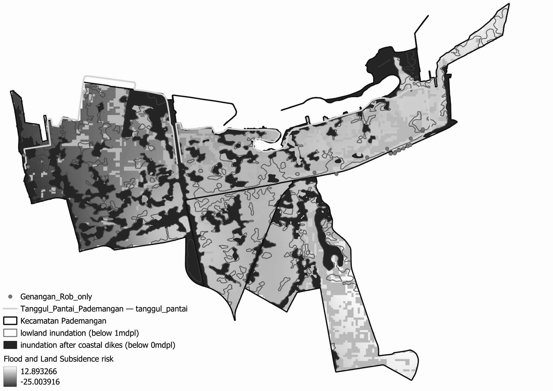
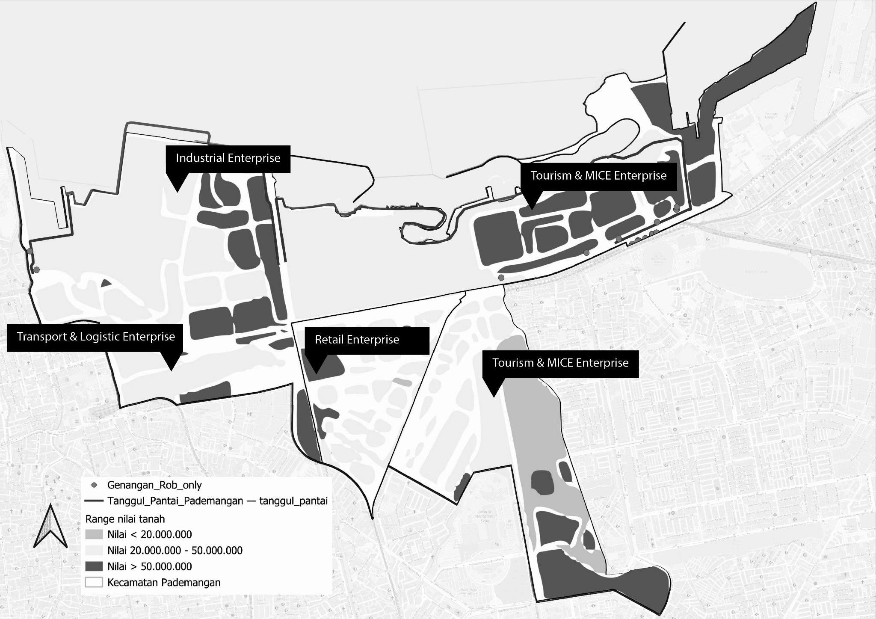
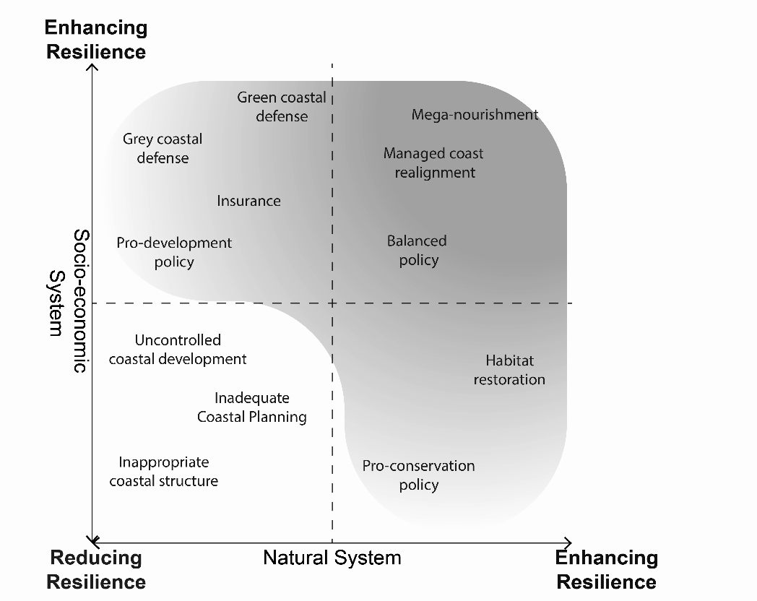
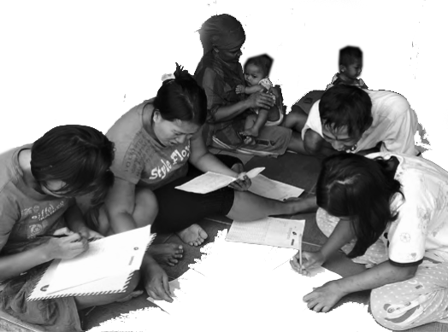
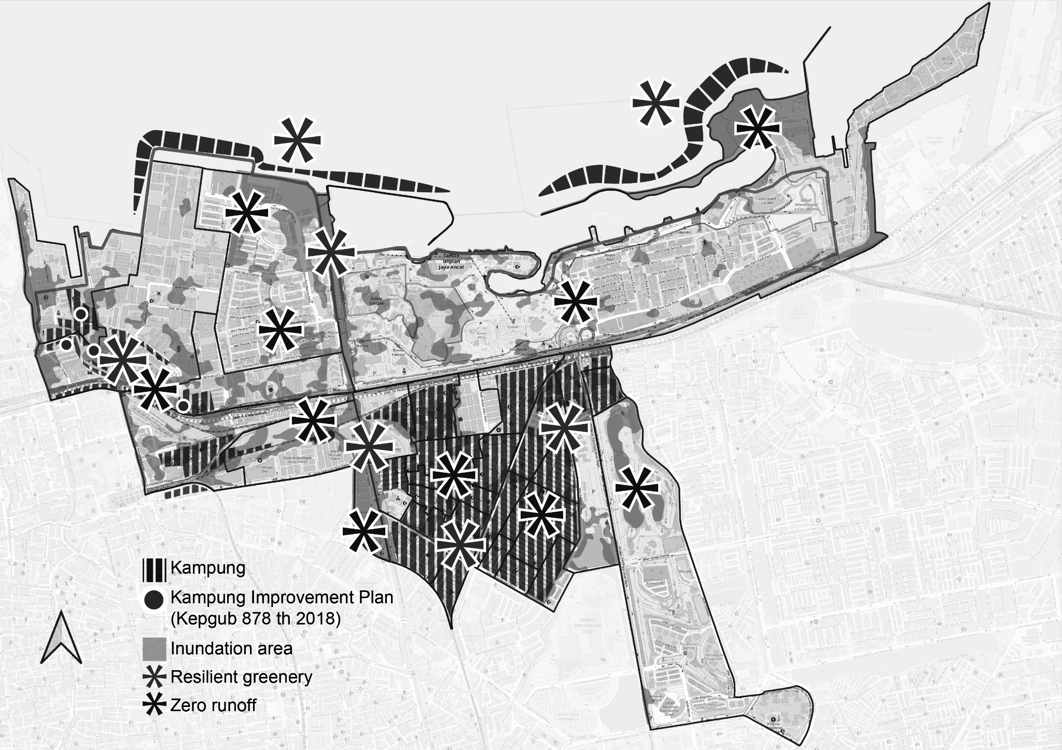
RECLAIMING COASTAL RESILIENCE
THROUGH COLLECTIVE PLANNING

Slide 13
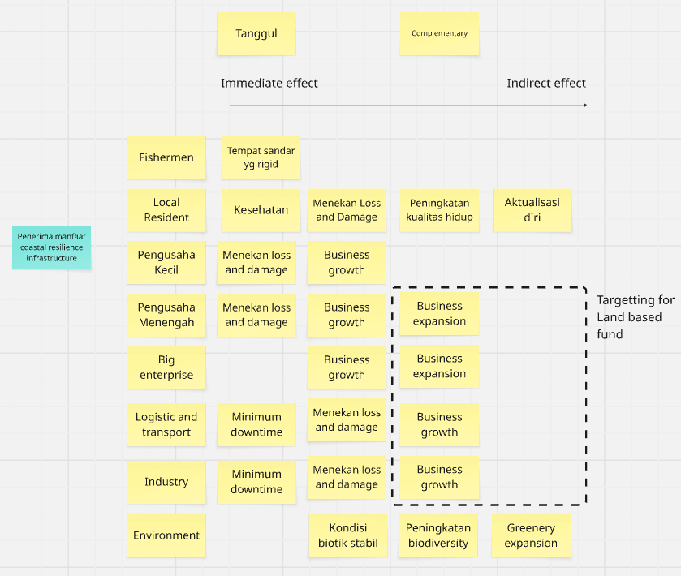
Reclaiming Resilience with Land Based Financing
Kampung Resilience Project List akan dibiayai dgn skema in-kind contribution (development-based) dari LBF
Jelasin ada insentif pembebasan pajak inreturn to Value Capture
Apa justifikasi Kampung resilience project list ini?
Dengan adanya complementary measures ini, maka biaya kerusakan aset jadi nol/minim
Usaha lebih lancar, jadi ada potensi kenaikan pajak karena profit meningkat
LAND-BASED FINANCING
Value Creation through policy & spatial planning
Value Capture Instruments
COLLECTIVELY RECLAIMING COASTAL RESILIENCE
Project List (For Fund Allocation)
THROUGH LAND BASED FINANCING
Project List (Need Funding)
Collective action & Knowledge sharing
Local vulnerability & Community priorities
KAMPUNG COMMUNITY PLAN

Slide 14
Kebutuhan Mapping:
Menjelaskan ambil sampel di kecamatan pademangan, karena salah satu tanggul pantai kritis ada di kecamatan ini.
Bagaimana kita menentukan:
Siapa yang membayar, dan seberapa besar
Zona nilai tanah, njop kuning dan merah diintersect sama kampung, yg diluar area kampung jadi target land based financing (winu)
Intersect pola ruang
Area yang perlu diintervensi oleh project resilience
RW di area rawan banjir dan land subsidence
Potensial area buat RTH dan ekosistem pesisir

Slide 15
Policy Brief
Intro Why does it matter LVC potential and Benefit Foundational Guidelines Regulatory Tools Recommendation Conclusion Appendix
Value Creation
Value Capture
Value Funding

Slide 16
Kampung Pilot Community Plan
Introduction: Konteks irregular settlements di Jakarta Utara Lokasi hasil pemetaan risk map Envisioning masyarakat berdaya/citizen power Existing condition of jaringan kampung
Problem Statement: Kampung flood resilience goals Financing Issue Legal Principle, System, and Management Issue
Community Action Plan Guideline Forming collective action and agreement Creating resilience plan Important guidelines (general design and planning principle) System and Management

Slide 17
Risk Mapping: How do we map
Locus: Jkt Utara > Pademangan (Konteks What how why pademangan) Main Data showcase:
Ecological Risk
Urban Morphology
Community Vulnerability
Sistem scoring sama grading area pada risk mapping ini filter 1: Data irregular settlements: masuk ke policy framework atau pilot kampung? filter 2: nilai njop rendah-tinggi filter 3: rawan banjir filter 4: tingkat keterbangunan filter 5: proximity ke infrastruktur resilience tiap filter ada skala nya, antara 1-3, atau 1/0, kalau nilainya makin tinggi maka dia jadi area target prioritas
bisa ambil sampel 3 lokasi, buat mewakili tiap jenis intervensi nya

Slide 18
Project List (Need Funding)
Collective action & Knowledge sharing
Local vulnerability & Community priorities
KAMPUNG COMMUNITY PLAN

Slide 19
Land Based Financing
Land-based financing is a mechanism used by the government to reap the unearned benefits experienced by increasing land value caused by public action (Alterman, 2012)
VIRTUOUS VALUE CYCLE
Value Creation
Collectively planning coastal flooding complementary measures that suits what locals need through Kampung Community Planning
Kampung Resilience Project List akan dibiayai dgn skema in-kind contribution (development-based) dari LBF
Jelasin ada insentif pembebasan pajak inreturn to Value Capture
Value Capture
Capturing the increase in land value enjoyed by positively affected stakeholders
The principle of land-based financing is founded on three main pillars of Virtuous Value Cycle (ADB, 2021).
With these coastal flood complementary measures in place, asset damage costs become zero or minimal. Businesses can operate more smoothly, creating potential for an increase in their land value.
Value Funding
Funding the planned coastal flood complementary measures from the captured value

